Slide 1
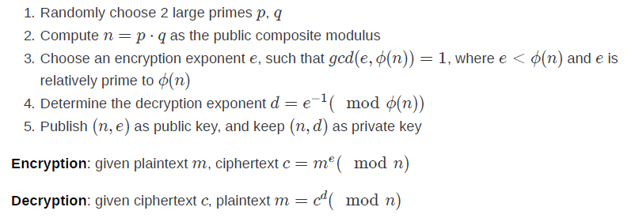

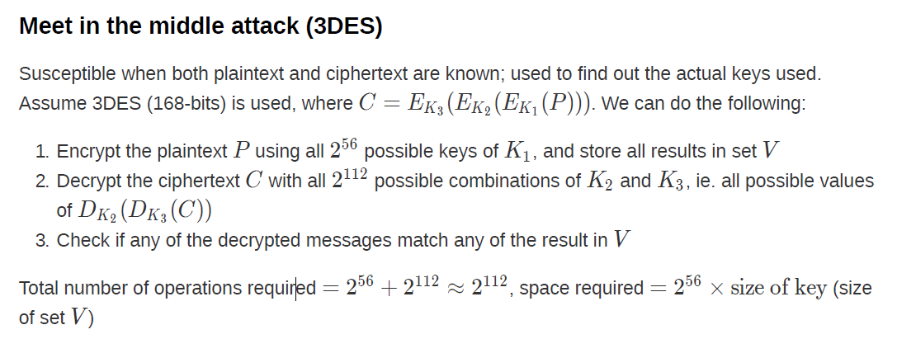


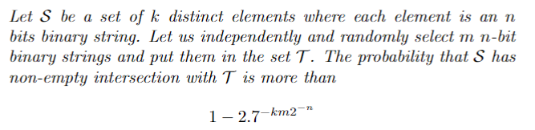
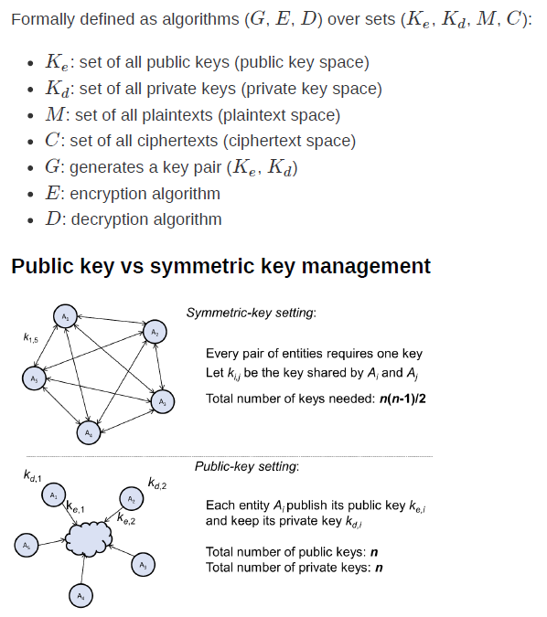
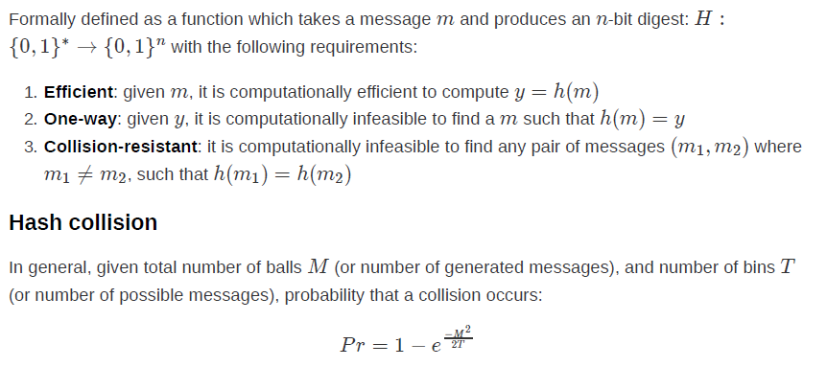
Parallelisability
ECB: both encryption and decryption
CBC: only decryption
PCBC: none
CFB: only decryption
OFB: none
CTR: both encryption and decryption
Authenticity and integrity
Authenticity implies integrity, but integrity does not imply authenticity
Authenticity is a stronger requirement than integrity
MAC provides authenticity but not non-repudiation
Padding Oracle Attack
Susceptible when given only the ciphertext and an oracle that gives validation upon whether a given ciphertext is correctly padded or not.
Variable-length plaintext messages have to be padded to be compatible with the underlying cryptographic cipher.
For plaintext P, decryption function D, secret key K, ciphertext C, and block number i,
baby rsa (Rivest-Shamir-Adleman)
p and q should be randomly generated and kept secret, large and have large difference
A singly-byte modification C1 in will result in a single byte change in P2.
Thus, exploit that to find out what the padding is:
Padding is always done on the last block (ie. last plaintext block contains the padding information)
Use guess and check method by:
1. Changing the 2nd last ciphertext block, byte by byte, from left to right (which will affect decoded data of the last plaintext block, and hence potentially affecting the padding information)
2. Checking each change with the decryption service till a padding error is thrown (byte where the error is thrown till the end of the block is the length of the padding)
BIRTHDAY ATTACK
Probability of Collision
PKC
Public (Asymmetric Key): uses two different keys for encryption and decryption
M – sample size
T – total possibilities
two pool variant
Cryptographic hash: function that takes an arbitrarily long input message, and outputs a fixed-size digest.
Good hash function:
Protect secret with mac
If hash function is resistant to collision attack, then it is also resistant to one way and 2nd preimage attack
Collision Attack: 2 inputs can be found that both result in the same hash
2nd Preimage Attack: Attacker given a specific input then finds another input that produces the same hash
Birthday Attack: Brute force collision
Protect secret with digital signature
A certificate is simply a document signed by a CA. (1) An identity, (2) The associated public key, (3) The time window that this certificate is valid, (4) The signature of the CA. • The document binds (2) to (1). It is certified by (4)
For ENCRYPTION
Public key encrypts, private key decrypts
For DIGITAL SIGNATURE
Private key encrypts, public key decrypts
Digital certificate verifies authenticity and certifies ownership of a public key
PKI is a standardised system to distribute public keys

Slide 2
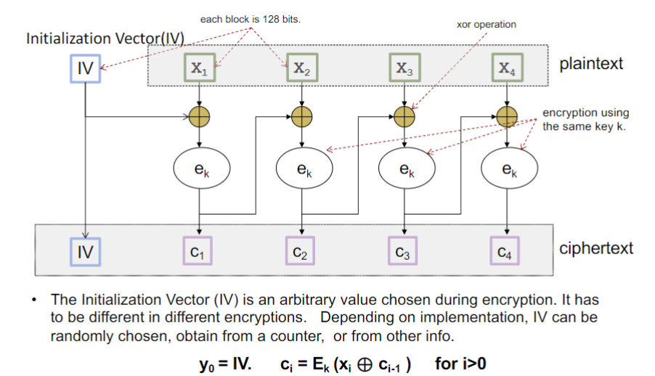
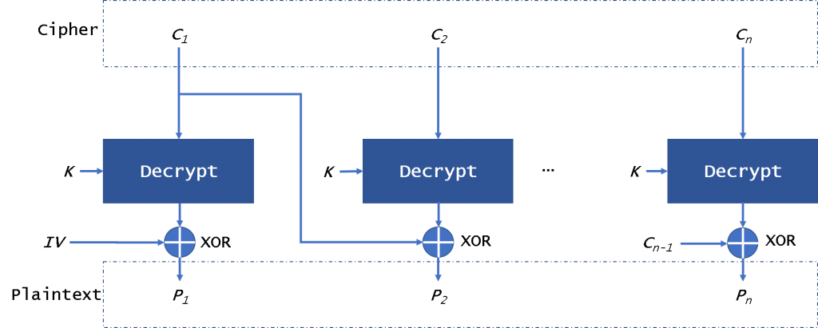
Kerckhoffs' Principle: states that the security of a cryptosystem must lie in the choice of its keys
only; everything else (including the algorithm itself) should be considered public knowledge
Key space: set of all possible keys
Key space size: total number of possible keys
Key size or key length: number of bits required to represent a particular key
False match rate (FMR): measures the percent of invalid inputs that are incorrectly accepted
False non-match rate (FNMR): measures the percent of valid inputs that are incorrectly rejected
Equal error rate (EER): rate when FNMR = FMR
Failure to enrol rate (FER): rate at which attempts to create a template from an input is
unsuccessful
Failure to capture rate (FTC): probability that the system fails to detect a biometric input when
presented correctly
Signature
Generated using asymmetric cryptography, gives a recipient very strong reason to believe that the message was created by a known sender, and that the message was not altered in transit.
Confusion: interceptor should not be able to predict what will happen to the ciphertext by changing one character in the plaintext
- Substitution achieves confusion
Diffusion: changes in the plaintext affect many parts of the ciphertext
- Good diffusion means that the interceptor needs access to much of the ciphertext to be able to infer the algorithm
- Transposition achieves diffusion
Bitwise XOR
0 if both bits are the same
1 if both bits are different
Electronic Codebook (ECB)
Message is divided into blocks
Each block is encrypted separately
Cipher Block Chaining (CBC)
Each block of plaintext is XORed with the previous ciphertext block before being encrypted
Each ciphertext block depends on all plaintext blocks processed up to that point
IV must be used in first block to make each message unique
Password Entropy
Online: 29 bits to be secure against online attacks, Recommends at least 49 bits for “higher security”
Offline: NIST recommends 128 bits
E = log2 (RL)
R - range of characters.
L - number of characters
Security Terminology
Confidentiality
Ensure that assets are viewed only by authorised parties
Prevention of unauthorised disclosure of resources
Availability
Ensure that assets can be used by any authorised parties
Prevention of unauthorised withholding of resources
Integrity
Ensure that assets are modified only by authorised parties
Prevention of unauthorised modification of resources
Authenticity
Ensure that assets are produced by the sender (or who we think the sender is)
Prevention of unauthorised forgery of resources
Non-repudiation
A situation where a statement's author cannot successfully dispute its authorship or the validity of an associated contract
MAC (Message Authentication Code)
When a shared symmetric key is used as part of the digest generation: H(m, K)
Repudiable: cannot prove to a third party exactly who produced the MAC
Can detect accidental/intentional changes to message and affirm message's origin for receiver
Guarantees integrity to everybody, but authenticity only to receiver (since it is repudiable)
Sender can deny previously sent message by claiming that the receiver spoofed it and sent it to himself
Sending example:
1. Sender hashes the message and the key to form the MAC (aka Authentication Tag): H(m, K)
2. Append H(m, K) to m, making (m, H(m, K)) -> send this to receiver
3. Receiver can calculate his own H(m, K) to check if either m or K has been altered
Kerckhoff’s Principle
One ought to design systems under the assumption that the enemy will immediately gain full familiarity with them
Mode-of-operation
Repeatedly apply a cipher's single-block operation to securely transform amounts of data larger than a block.
Initial Value
Block of bits to randomize the encryption and hence to produce distinct ciphertexts even if the same plaintext is encrypted multiple times
MAC
Short piece of information derived from a secret key to confirm that the message came from the stated sender and has not been changed.
Stream cipher
Approximating the action of a proven unbreakable cipher, the one-time pad.
Man-in-the-middle
Attacker secretly relays and possibly alters the communications between two parties who believe that they are directly communicating with each other.
AES CBC Encryption & Decryption
Zero-day: vuln that devs were unaware of/no time to address

